Slide 1
Effects of hyper-hydration on orthostatic tolerance in men and women
Alexa brooks
Dr. Sara Jarvis
Northern Arizona university
Notes:
Hi my name is Alexa Brooks, and I am from NAU. My mentor for the current project was Dr. Sara Jarvis, and we looked at the effects of hyperhydration on orthostatic tolerance in men and women

Slide 2
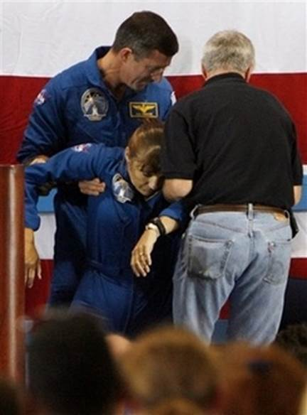
Introduction
Interventions
Hyper-hydration
Salt supplementation
Purpose:
Determine effects of hyper-hydration with Gatorade on orthostatic intolerance
Hypothesis:
Men and women will show increases in orthostatic tolerance
Relative improvements will be similar between sexes
Notes:
A potential risk factor to astronauts is post-spaceflight orthostatic intolerance, or the inability to maintain blood pressure in the upright posture. This is a very common crisis in returning astronauts on landing day. For example, about 20% of all astronauts (100% of women) experience symptoms of orthostatic intolerance upon returning spaceflight, including lightheadedness, loss of peripheral vision, a sudden drop in systolic blood pressure, or even passing out.
During spaceflight, astronauts will experience a loss of plasma volume, which may be one contributing factor to orthostatic intolerance. One way to offset and minimize plasma volume loss is through a good hydration strategy.
Previous studies have shown that hyper-hydration with creatine and glycerol and salt supplementation over the course of multiple weeks has increased plasma volumes and orthostatic tolerance. Hyper-hydration may be an important countermeasure for orthostatic intolerance.
Bed rest and exposure to microgravity has been shown to shift fluid from the extracellular space to the intracellular space (2). Gatorade is rich in sucrose, which will stimulate fluid absorption in the small intestine, while the sodium in Gatorade will help retain water in the extracellular space (14).
Thus, the purpose of this investigation was to determine the effects of euhydration vs. hyper-hydration with Gatorade on orthostatic intolerance in both women and men. We hypothesized both groups will demonstrate improvements in orthostatic tolerance. We also hypothesized that the relative improvements will be comparable between the sexes.

Slide 3
Methods
Subject Characteristics
 | Men (n=8) | Women (n=7)
Age (years) | 21±4.5 | 21±0.5
Height (meters) | 1.8±0.1* | 1.7±0.1
Weight (kg) | 67.7±6.9 | 61.9±10.4
BMI (kg/m²) | 22.1±3.0 | 21.9±2.6
Resting SBP (mmHg) | 116±8.6 | 114±9.2
Resting DBP (mmHg) | 69±6.9* | 77±5.4
Resting HR (bts/min) | 67±10.6 | 80±12.4
Values are mean±SD, *Significant difference between sexes
Notes:
We are still in the process of collecting data, so for the purpose of this presentation, we analyzed about half of our subjects.
15 healthy men and women (Table 1-Characteristics) over 18 years of age gave their written informed consent before participating in the present study, which was approved by the NAU IRB committee.
When comparing baseline measurements, there was a significant difference between men and women in terms of height and DBP.

Slide 4
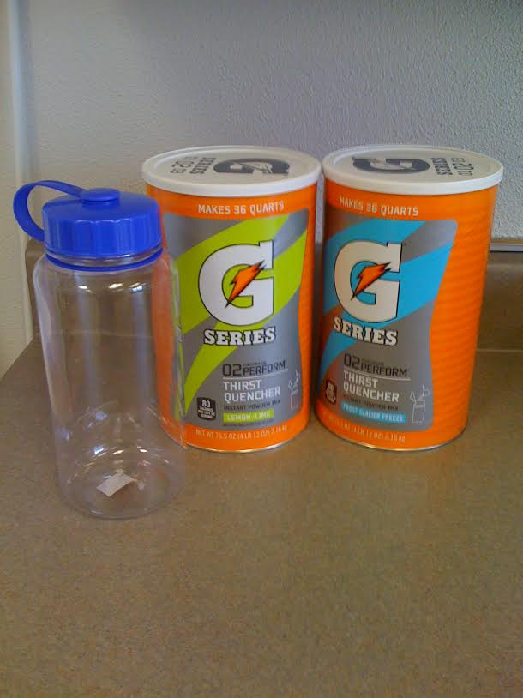
Methods
2 randomly assigned sessions
Euhydrated
6 days
normal food intake
Hyper-hydrated
6 days
2 L Gatorade/day
Tilt Test
1 L
Notes:
The subjects reported to the lab for two testing sessions (randomly assigned): once in a euhydration state (which is your normal hydration status) and once in a hyper-hydration state (which is above normal hydration status). For the euhydration trial, subjects carried out their normal routine in regards to food and drink. However, during the hyper-hydration trial, subjects consumed 2 liters of Gatorade per day on top of normal intake for 6 days before the study and 1 liter the morning of the study.
The tilt test was used to assess physiological and orthostatic responses.

Slide 5
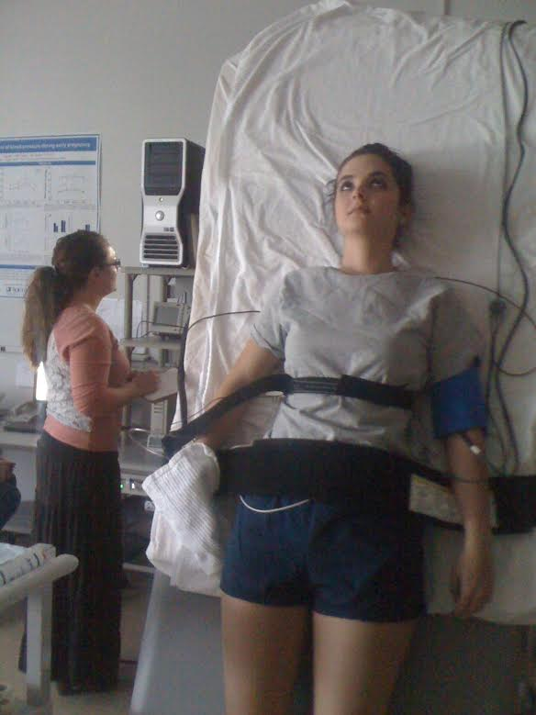
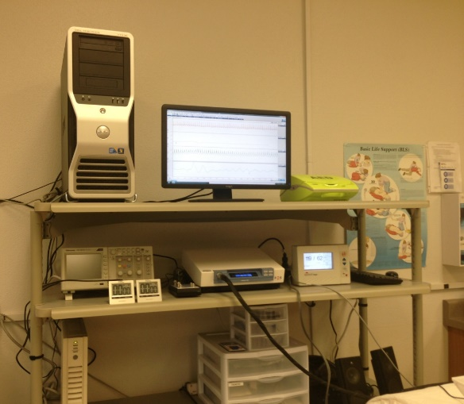
Data Collection
Electrocardiogram
SunTech Tango
BP from brachial artery
Finometer
Beat to beat BP from finger
Chest Strap
Breathing rate
Tilt Test
Notes:
On the day of the study, the subjects remained supine for a 5 minute baseline, after which the subject was tilted to 70⁰ (head-up) for 45 minutes or until presyncope. Subjects were instructed to relax and keep their knees locked. The test was immediately terminated if the subjects complained of any abnormal symptoms (dizziness, light-headedness, nausea, difficulty breathing, heat) and the subjects remained supine for a 5 minute recovery. We monitored heart rate, blood pressure, breathing rate, and assessed tilt time during the tilt table test.

Slide 6
Results
* †
*
* Significant difference during HUT
† Significant difference between sexes
Notes:
Data reported are means ± standard deviation. Statistical analysis was carried out using three way and Two way analysis of variance to compare variables. T-tests and paired t-tests were used to compared baseline measurements and were carried out using excel. Statistical significance was declared as P < 0.05.
SBP did not change with HUT (114±* to 110±* mmHg from BL to HUT, respectively P=0.445, Figure 1 and 2) and was similar between groups (112±* vs. 112±* mmHg for men vs. women, respectively, P=0.979 Fig. 1 and 2).
DBP was higher during HUT (68±7 to 77±8 mmHg from BL to HUT, respectively, P= <0.001) and higher in women (69±9 vs. 75±8 mmHg for men vs. women, respectively, P=0.003).

Slide 7
Results
†
†
*
*
*Significant difference during HUT
† Significant difference between sexes
Notes:
HR increased during HUT (65±11 to 96±17 beats/min, P=0.03) and was higher in women (67±19 vs. 80±21 beats/min, P=0.024).

Slide 8
Results
†
† Significant difference between sexes
Notes:
Both sexes had similar responses to tilt and hydration statuses; however, men had longer tilt times (21 vs. 36 minutes, P=0.005).

Slide 9
Discussion
Salt supplementation
Increases:
Plasma volume
Total peripheral resistance
Orthostatic tolerance
Glucose
Decrease in peripheral resistance
Insulin will cause vasodilation
Things to consider:
Salt supplementation was ~6g/day for 8 weeks
Glucose ingestion was right before tilt
Notes:
The current study showed no difference in tolerance with Gatorade. The contrasting effects of salt and sugar on orthostatic tolerance contained in Gatorade could explain this.
Salt supplementation has been shown to increase mean pressure, TPR, plasma volume and orthostatic tolerance. Salt supplementation used about 6-7g/day for 8 weeks, while we only did about 1 g/day for 6 days. This may have not been adequate salt supplementation to see improvements.
When ingesting glucose water prior to tilt, it has been correlated with a decrease in total peripheral resistance relative to water. the decrease in TPR may be due to an increased vasodilation in the splanchnic circulation from glucose or the vasodilatory effect of plasma insulin. insulin concentration increases occur about 30 minutes after carbohydrate ingestion. It is hard to make a comparison with the current study because The carbohydrate and glucose studies administered the carbohydrates right before tilt, while our subjects were instructed to finish their last liter of Gatorade 4 hours prior to tilting, so subjects didn’t have to use restroom.
The decreased orthostatic tolerance in women compared to men are can be due to a multitude of factors, including: decreased peripheral resistance, decreased sympathetic nerve activity, smaller or less stretchable hearts, different response time and duration to orthostatic stress.

Slide 10
Conclusion
Men were more orthostatically tolerant than women.
Gatorade did not improve orthostatic intolerance.

Slide 11
Acknowledgements
Subjects who participated
Dr. Jarvis
Personnel of NAU’s Cardiovascular Regulation Lab
NAU/NASA Space Grant Internship
Arizona Space Grant Consortium

Slide 12
Thank you!
Any questions?

